Slide 1


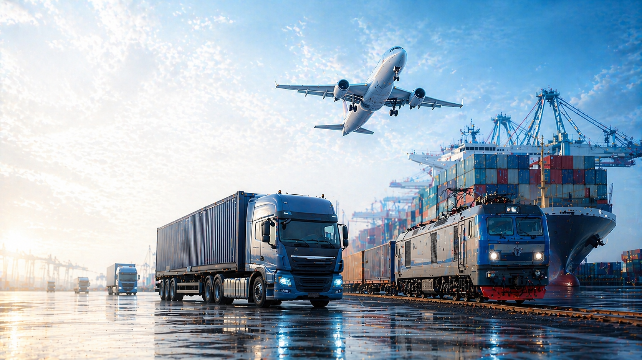
+7 (727) 331 18 18
info@colos.kz
www.colos.kz
Effective logistics solutions
CONSULTING AND PLANNING
TRANSPORTATION BY ALL TYPES OF TRANSPORT
DOOR-TO-DOOR DELIVERY
GLOBAL NETWORK
STORAGE
CUSTOMS CLEARANCE
24/7 MONITORING

Slide 2

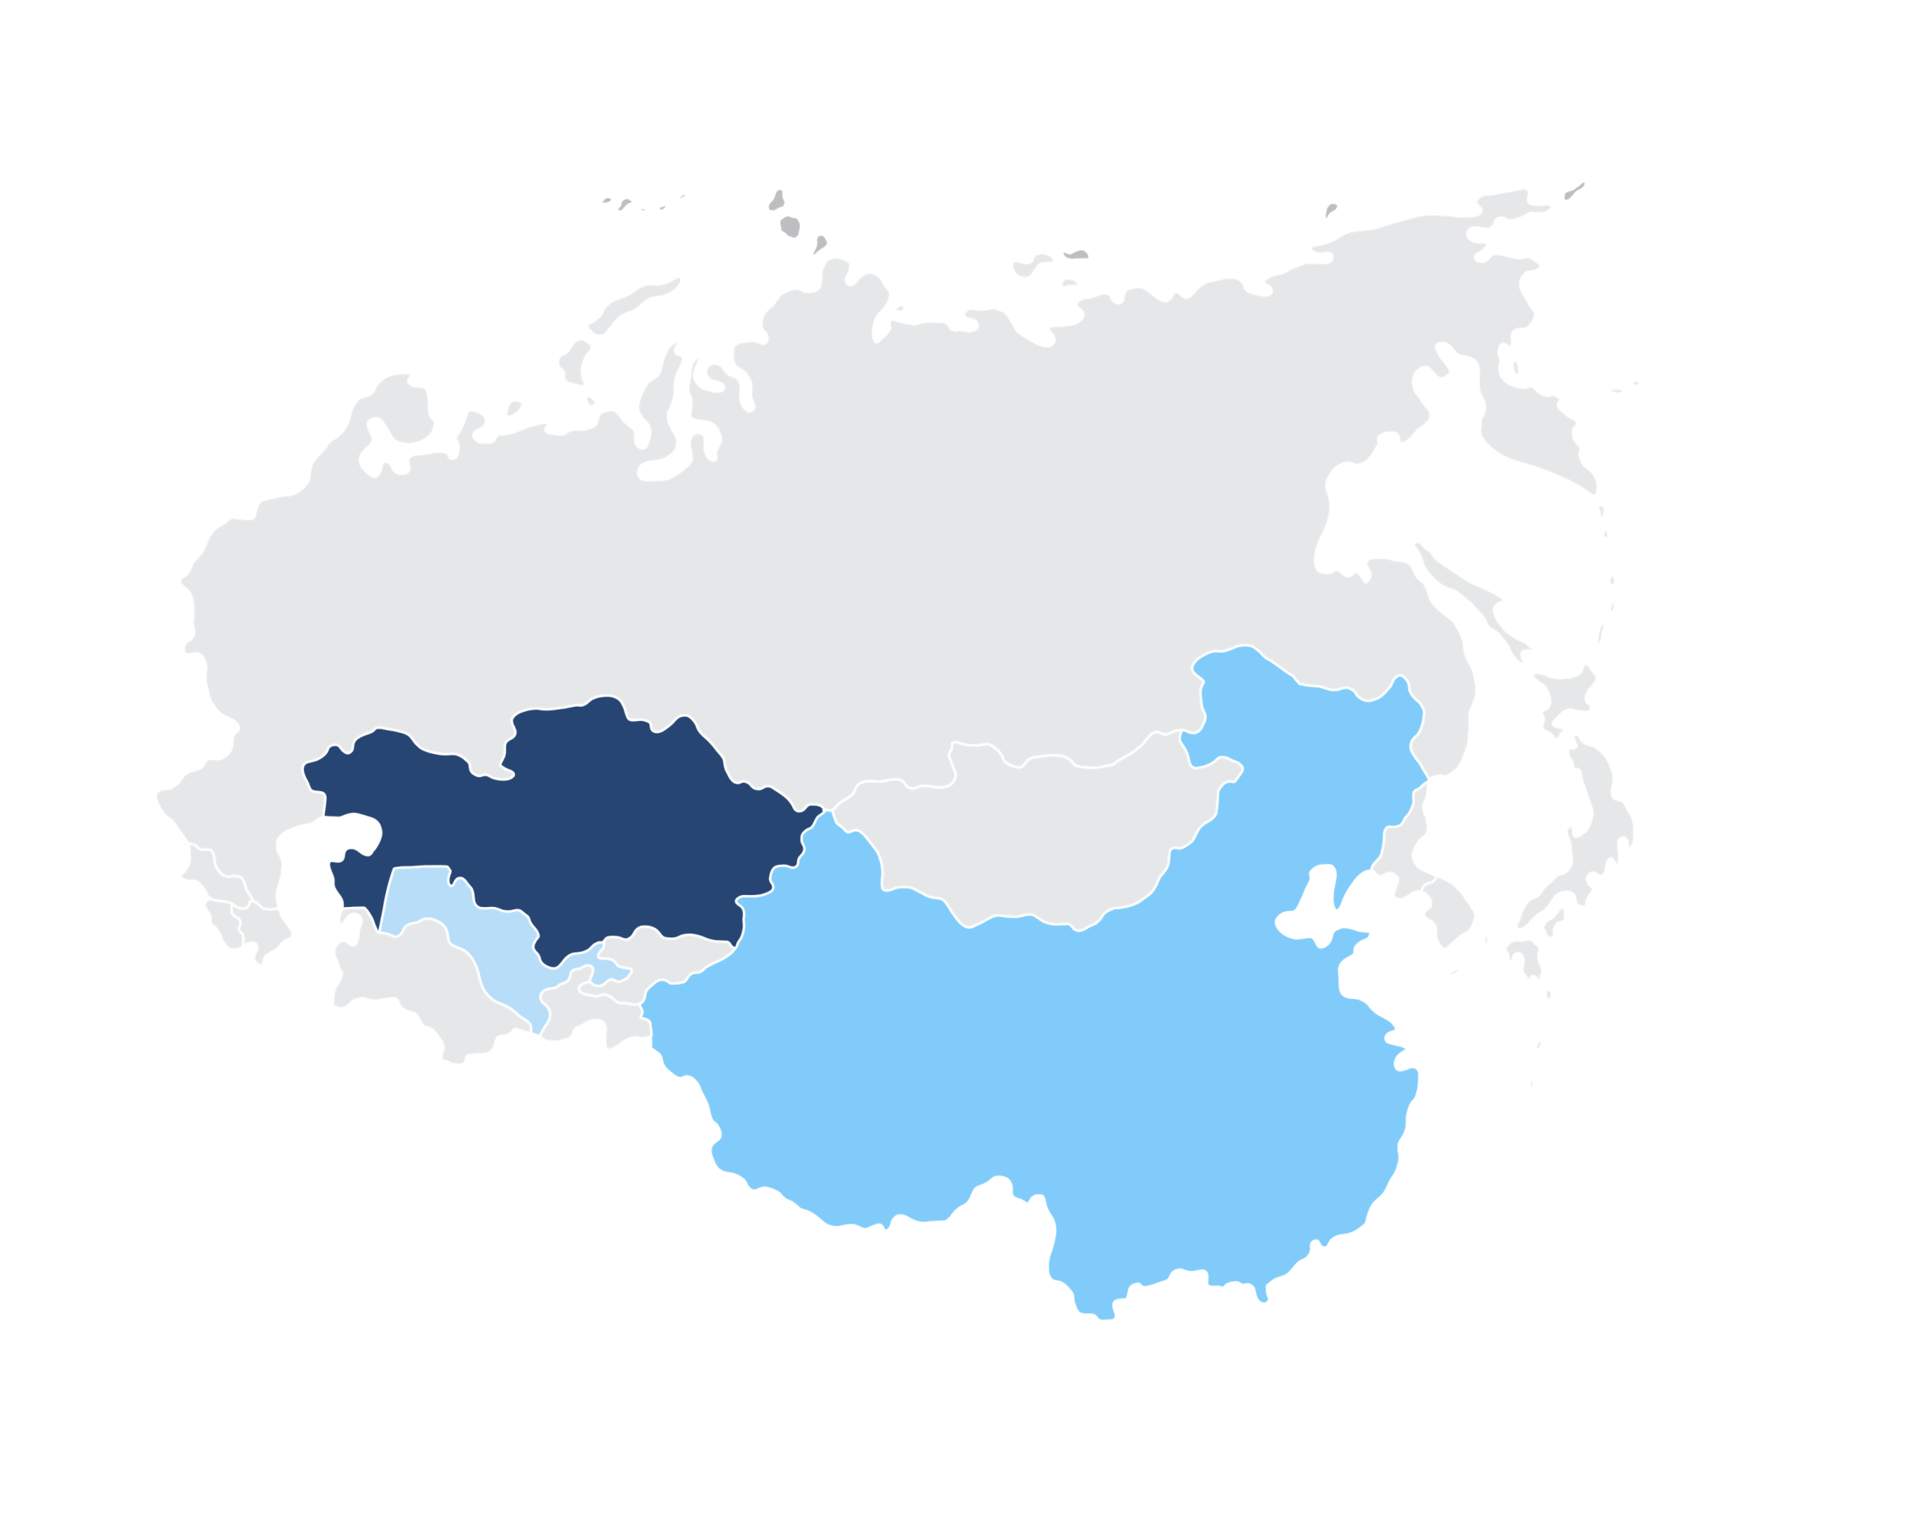
About the company
IFC COLOS LLP is a Kazakhstani freight forwarding company that provides
a full range of logistics services for the organization of transportation by all modes of transport:
Rail freight
Air freight
Road freight
Ocean freight
RUSSIA
MOSCOW
ATYRAU
ASTANA
KAZAKHSTAN
AKTAU
ALMATY
UZBEKISTAN
KHORGOS
storage and customs clearance of cargo in international and domestic traffic.
TASHKENT
CHINA
Combining the company's experience in the market since 2007 and international quality standards, we have become a reliable partner for over 1,000 organizations: from small businesses to the public sector and global corporations.
IFC COLOS OFFICES IN KAZAKHSTAN AND UZBEKISTAN AND REPRESENTATIVES IN RUSSIA AND CHINA ARE AT YOUR SERVICE
2

Slide 3



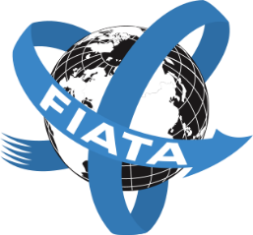


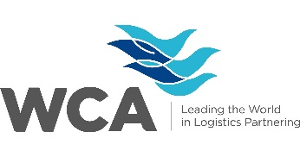

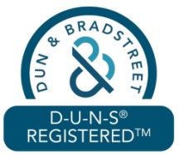
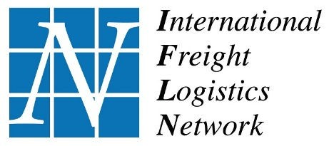
Facts about us
Over
More than
More than
Over
20
100
100%
1000+
500К
100К
years
of market experience
qualified freight forwarders
KAZAKHSTAN COMPANY
SATISFIED CLIENTS
tons of cargo were transported
customs declarations processed
WE TRANSPORT CARGO TO ANY POINT IN THE WORLD
ISO 9001:2015 certified management system
ISO 45001:2018 certified occupational health and safety system
ISO 14001:2015 certified environmental management system
We are a member of the International Federation of Freight Forwarders Associations (FIATA)
We are a member of the Kazakhstan Association of Carriers and Wagon Operators (KAZAPO)
We are a member of the National Association of Freight Forwarders of the Republic of Kazakhstan (ANEK)
We are a member of the World Cargo Alliance (WCA ID: 91372)
We are a member of an international freight forwarders network
We are a member of a global network of logistics companies and independent freight forwarders
We are registered in the D-U-N-S register (D-U-N-S® Number: 685535118)
3

Slide 4

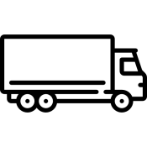
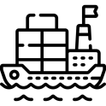
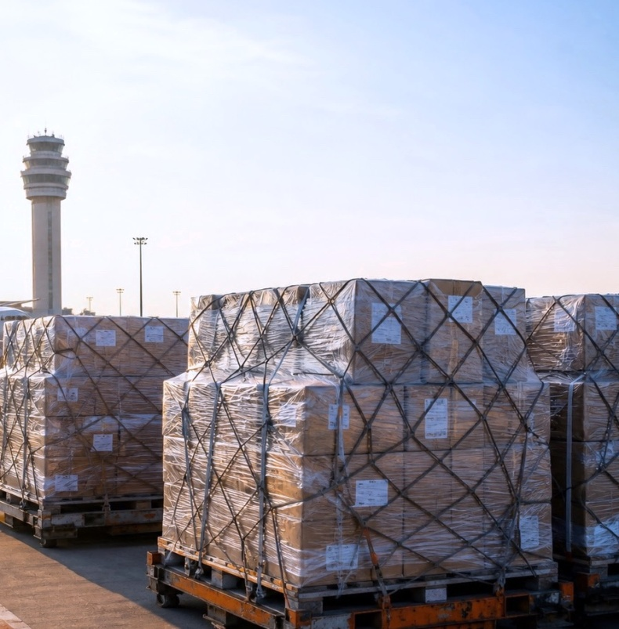







Our services
RAILWAY FREIGHT
ROAD FREIGHT
OCEAN FREIGHT
CUSTOMS BROKERAGE SERVICES
AIR FREIGHT
MULTIMODAL/ INTERMODAL FREIGHT
PROJECT LOGISTICS
CONTAINER FREIGHT
Terminal handling services
4

Slide 5


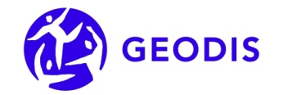





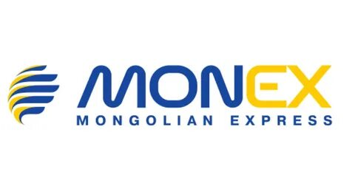












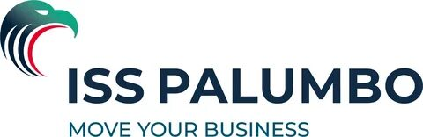




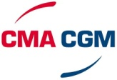
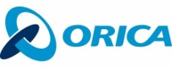


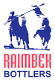








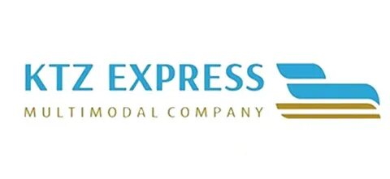

Trusted by
Our reputation is built on years of collaboration with industry leaders who trust us to manage their most complex supply chains.
OUR CLIENTS
OUR PARTNERS
5

Slide 6

Benefits for customers
Global network
Own fleet of railway wagons
Optimal routes.
Coordination of contractors and freight.
Customs clearance.
Last-mile delivery.
Representative offices in major cities of Kazakhstan, Uzbekistan, Russia, and China.
Partnerships with global logistics networks.
Access via all modes of transport (international and domestic).
Own fleet of open wagons (gondolas) and flatcars (60-foot).
Extensively operating a leased and managed fleet (covered wagons, tank containers/cars, hopper cars, refrigerated wagons, and dump cars).
Digital service and support 24/7
GR support and ISO-certified quality
4PL expertise
Logistics on your smartphone.
Transparent invoicing and tracking.
24/7 cargo monitoring without phone calls.
20 years in the market: leadership and strong industry connections.
GR and consulting: lobbying and protecting business interests.
Security: legal support and international quality audits.
We design logistics and grow your business.
We manage your logistics ecosystem.
We handle the complexity and focus on your growth.
6

Slide 7

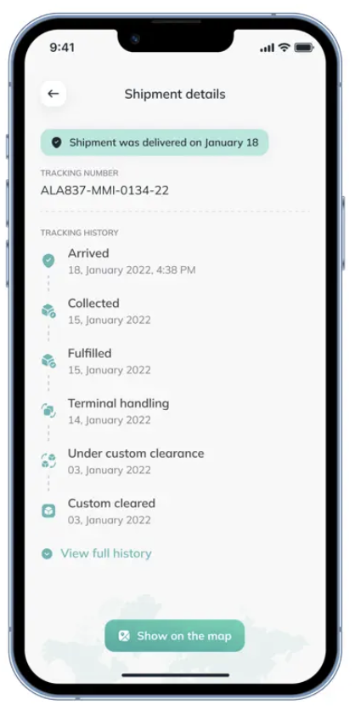
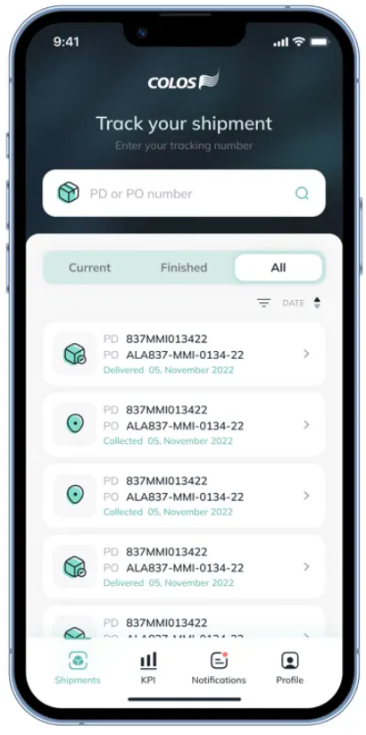
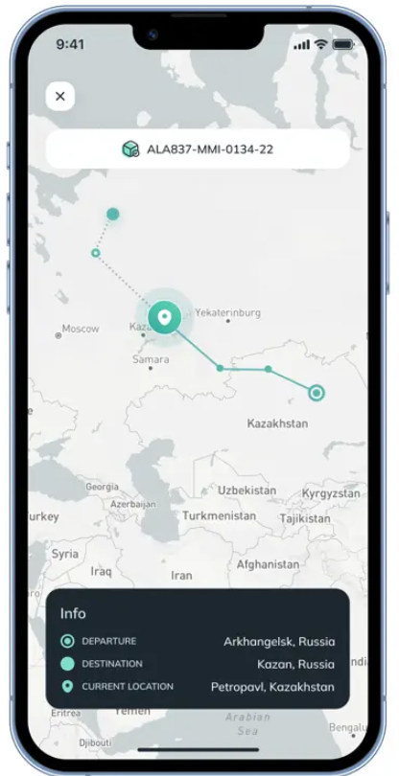




Digitalization of customer relationships
For our clients' convenience, we've developed an online service, the "Client Account“, accessible via our website and mobile apps for iOS and Android. With this service, clients can:
Send requests to our freight forwarders for cargo transportation and other services.
Track request statuses.
Track shipments/services, their status, and location.
Get access to accompanying documents.
Set up and receive push notifications in the app and/or via email.
7

Slide 8
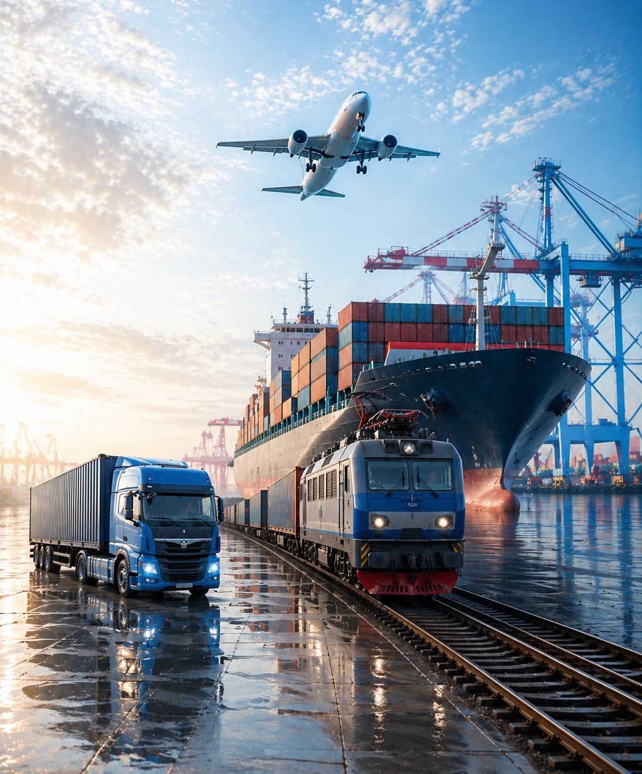

Multimodal/Intermodal Freight with IFC Colos
IFC COLOS is one of the most experienced multimodal freight forwarders in the country. We design and implement door-to-door logistics chains using various modes of transport of any complexity under a single contract.
Global agent network: covering all continents.
One-stop shop: One contract and one manager for all modes of transport. Schedule coordination, document processing, and transhipment services are handled by IFC COLOS.
Door-to-door transportation by various modes of transport.
Smart routing: Selection of optimal routes based on border and port conditions.
Prompt interaction between participants at every stage of delivery, including cargo handling during transhipment between different modes of transport at the terminal.
Control and monitoring: Systematic monitoring of cargo locations.
8

Slide 9


Road Freight with IFC Colos
Flexibility and efficiency without limits
Any loading format: Efficient handling of full truckload (FTL) and less-than-truckload (LTL) cargo to optimize your budget.
Specialized transport: Transportation of restricted (REF), hazardous (ADR), fragile, and oversized cargo in compliance with all international standards.
Express delivery: Optimized delivery times for critical deliveries.
Extensive route network: Direct routes between Europe, China, and Central Asia.
24/7: 24/7 tracking of your shipment status in the mobile app.
9

Slide 10
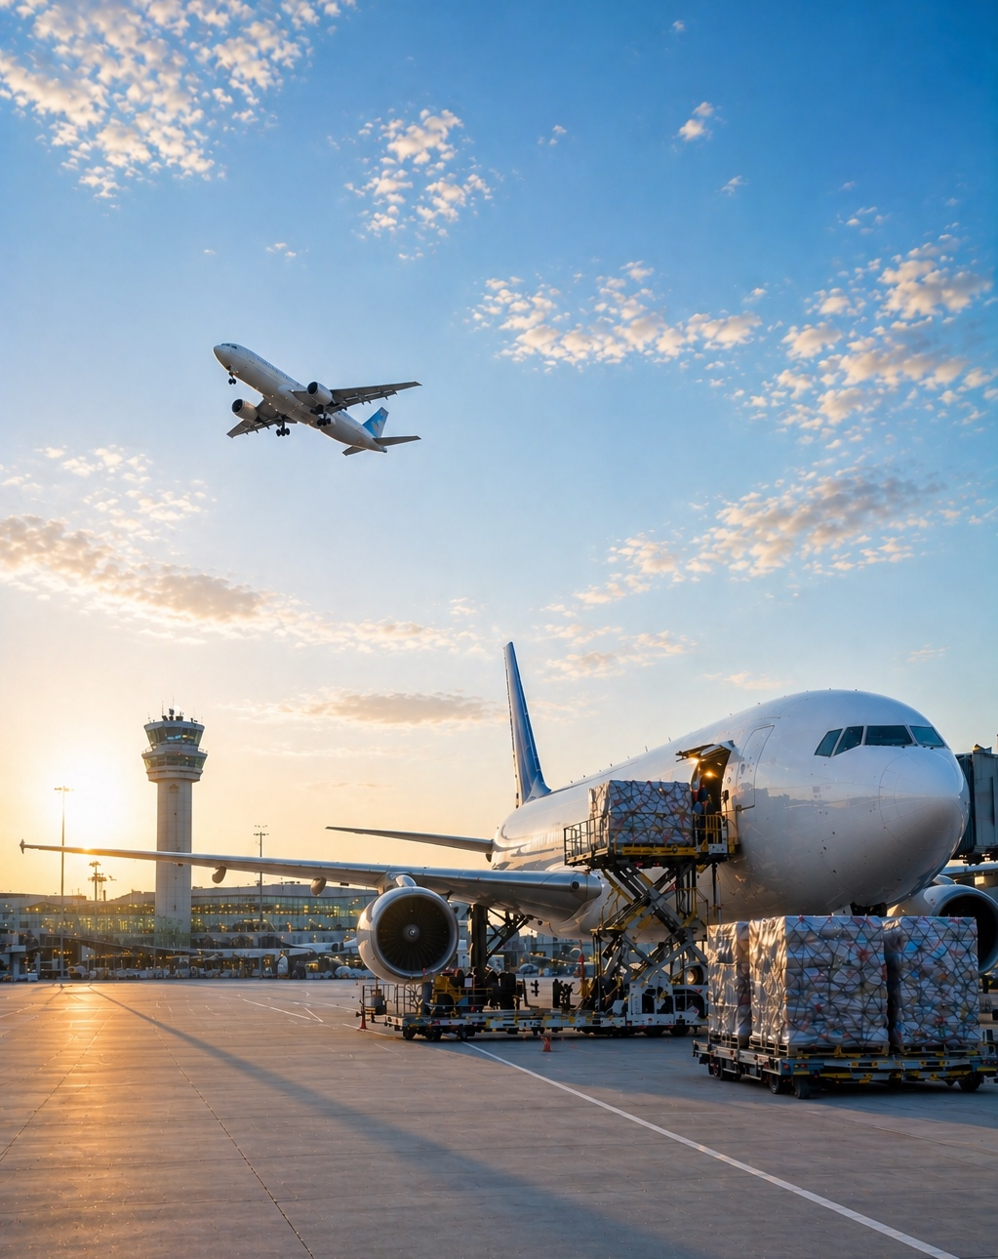


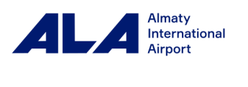
Air Freight with IFC Colos
Fast and secure delivery to anywhere in the world!
Global coverage: Direct flights to all key global hubs and reliable service in over 190 countries.
Urgent and critical cargo (spare parts, electronics, pharmaceuticals, etc.)
Professional handling of valuable, hazardous (GDR), and temperature-sensitive cargo in compliance with IATA standards.
Charter flights for large-scale project assignments and non-standard equipment, as well as scheduled flights.
Priority seat reservations on leading airlines. IFC COLOS is a cargo agent for Air Astana and Lufthansa and cooperates with all major air carriers.
For the convenience of our clients, we have an office at Almaty International Airport!
10

Slide 11
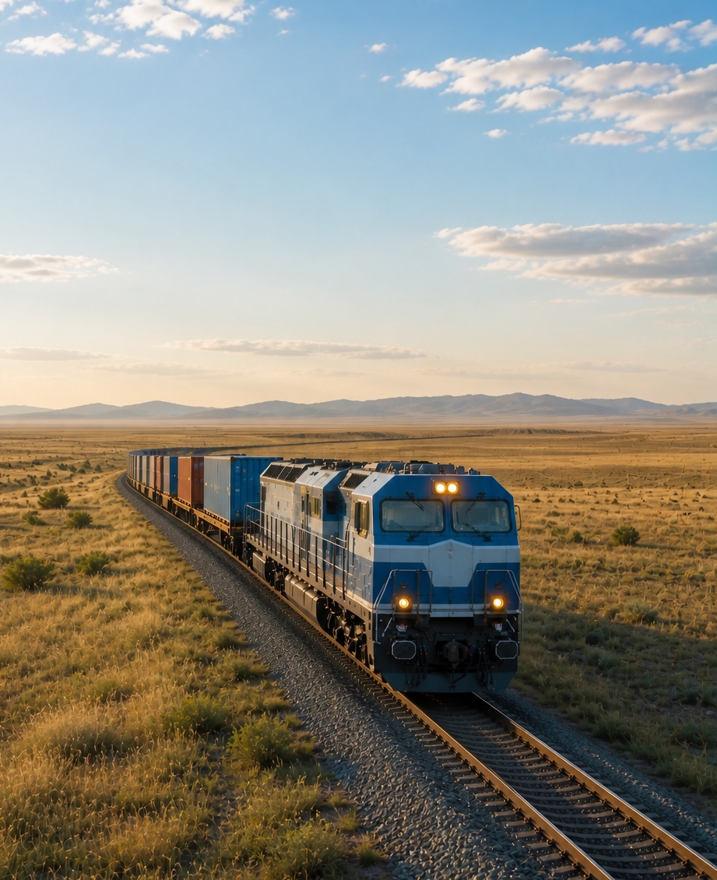

Rail Freight with IFC Colos
Scale, reliability, and stability of your deliveries in any season!
Our own fleet: fixed rates and availability of loading space on our gondola cars and flatcars.
Our external fleet: a wide selection, partner rates for covered cars, tank cars, hopper cars, refrigerated trucks, and dump cars.
Technical consulting: Development and coordination of complex loading and securing schemes, optimization of oversized and non-standard shipments.
Full-cycle cargo handling at key stations in Kazakhstan, Uzbekistan, and border areas of China.
Regular routes throughout the CIS network, the Baltic countries, and to Caspian Sea ports.
FCL shipments from China, Europe, the CIS countries, and along the Trans-Caspian International Transport Route.
Construction of block trains tailored to your needs.
11

Slide 12
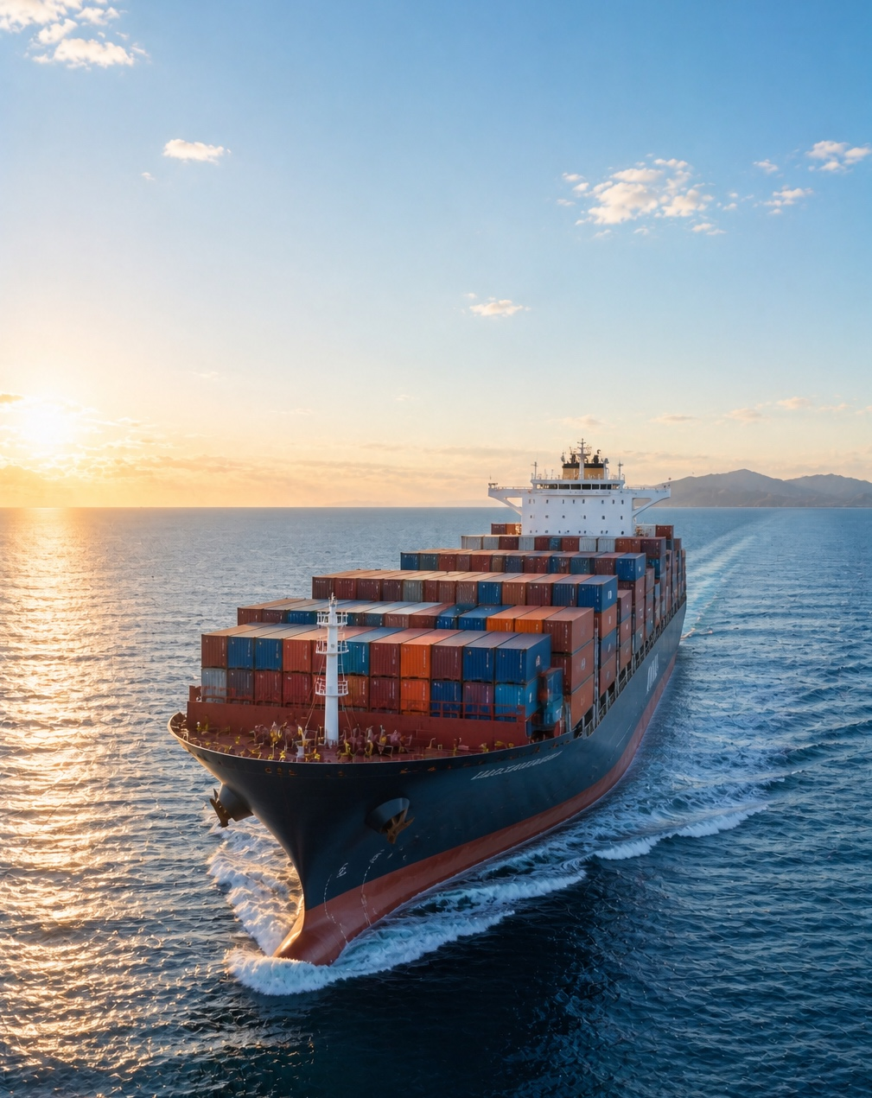

Ocean Freight with IFC Colos
Long distances at minimal cost and coordination with other modes of transport
We organize chartering of vessels, barges, and feeders tailored to individual client needs, with optimal cargo capacity and delivery times.
Direct contracts with leading shipping lines with priority booking and competitive rates.
Port services and a full range of terminal operations, including transit customs clearance at ports (consolidation, temporary storage, and distribution).
Certified organization for the transportation of dangerous goods by sea (IMDG), in compliance with all international conventions and safety standards.
12

Slide 13
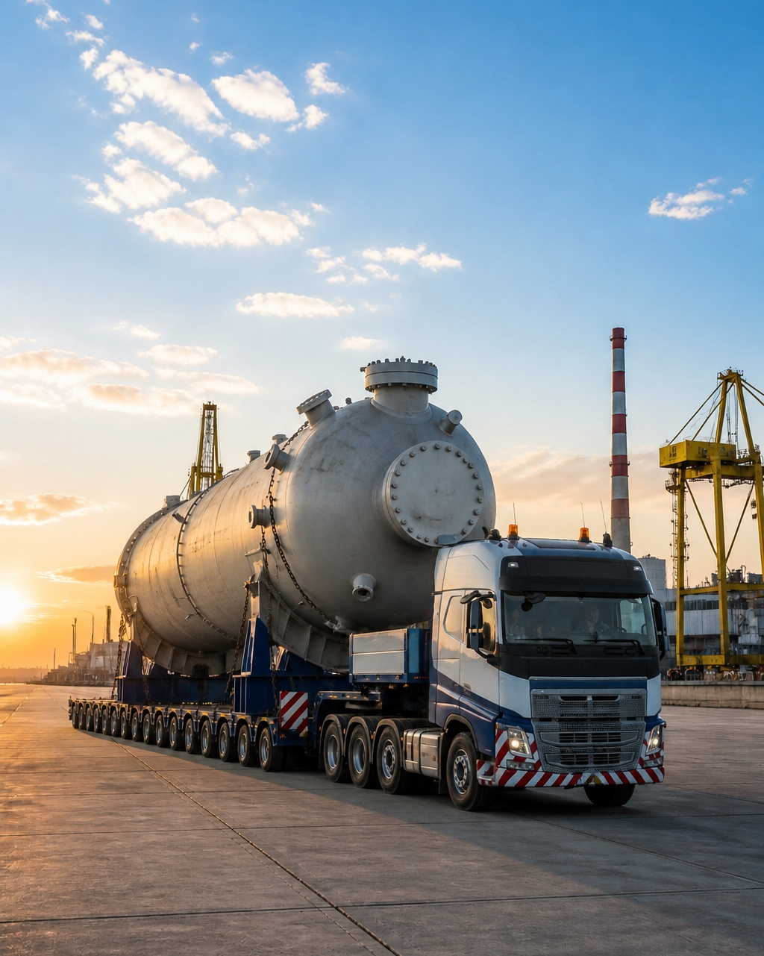

Project Logistics with IFC Colos
Transportation of oversized, heavy and non-standard cargo for industrial enterprises according to agreed schedules
Extensive experience and expertise in project logistics with cargo weighing over 100 tons and non-standard dimensions.
Logistics planning for super-heavy and oversized objects, taking into account the specifics of the rolling stock.
Turnkey solutions: Full project responsibility, from planning to installation.
GR and full support in obtaining special permits, organizing police escorts, and coordinating routes with government agencies.
Risk management: Insurance coverage and strict safety controls at every stage, from the factory floor to the foundation of the project site.
13

Slide 14
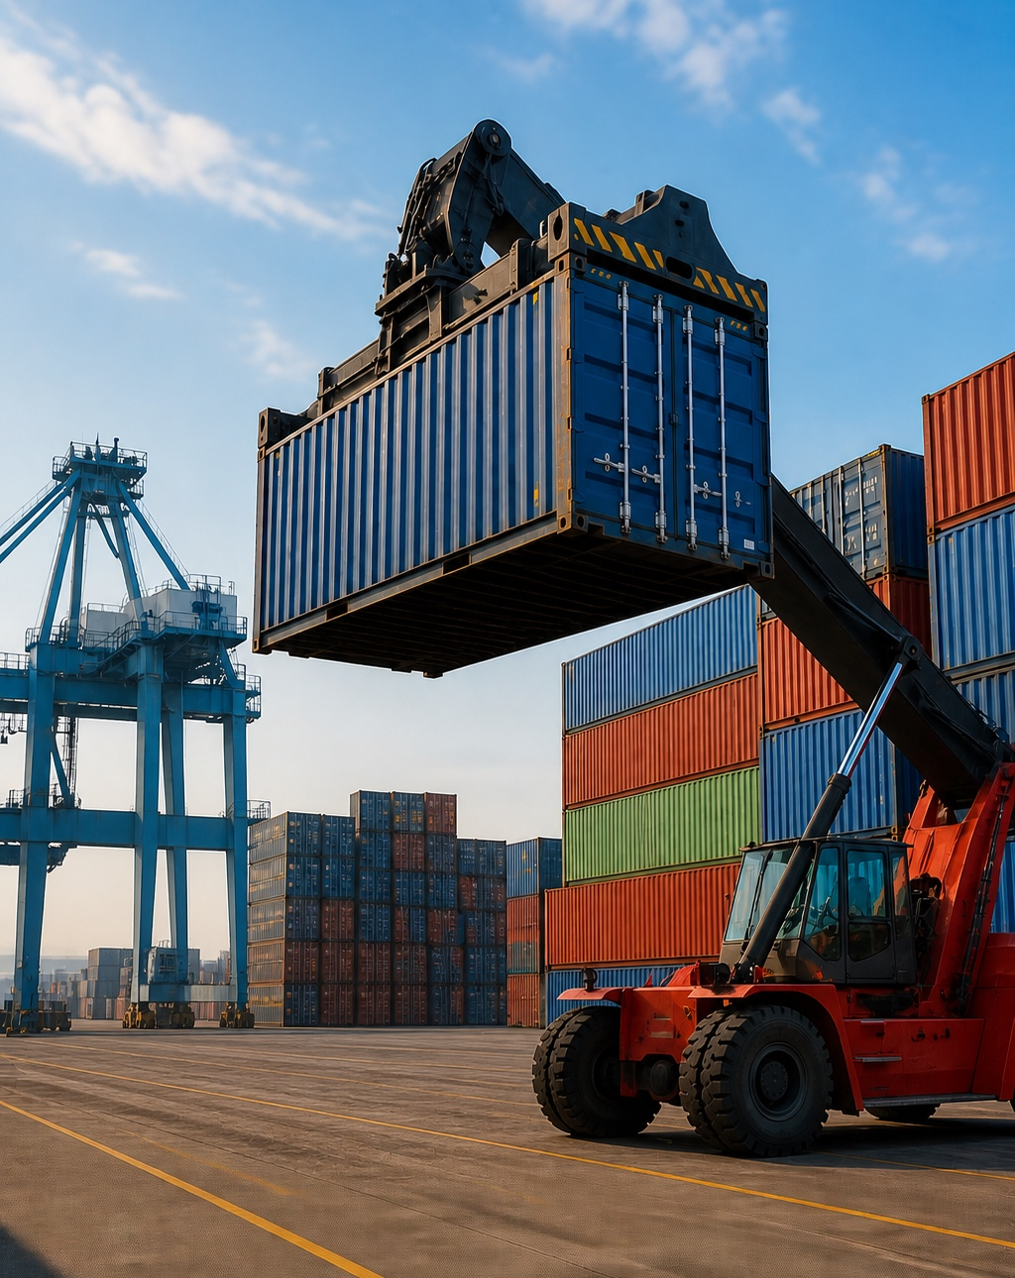

Container Freight with IFC Colos
High level of protection from weather factors and possible theft, using the container as a single, protected unit of transportation and a high level of service!
FCL and LCL solutions: We organize full container load (FCL) and less-than-container load (LCL) shipments, optimizing costs for both large and small businesses.
Express container trains: Regular services to key destinations (China, Kazakhstan, Uzbekistan, the CIS, and Europe) with minimal transit times.
Owned and leased fleet: Access to a wide range of container equipment (20' DC, 40' HC, Open Top, and Flat Rack) to suit any needs.
End-to-end service and a full range of terminal services: consolidation, storage, stuffing/unstuffing, and preparation of all shipping documentation.
Temperature-controlled transportation with temperature control at every stage of transportation and digital monitoring of the supply chain.
14

Slide 15
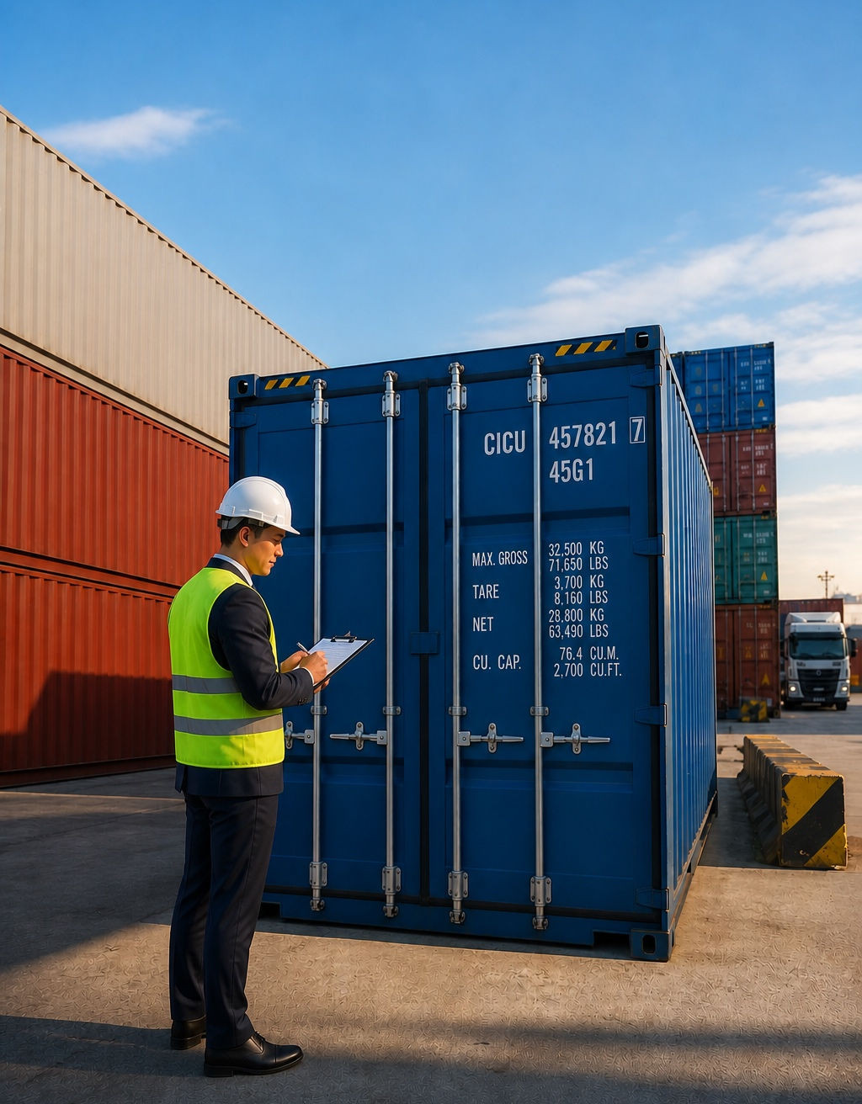

Customs brokerage services from IFC Colos
We ensure prompt and timely filing of declarations and minimize errors.
Export and import. Timely declaration submission
Vehicle Type Approval / Certificate of Vehicle Structure Safety (With / without emergency SOS button)
Simplified declaration. Reduced customs inspection times
Radio-electronic systems and high-frequency devices. Import licensing and expert conclusions
Preliminary Customs Decisions. Verification and confirmation of commodity classification codes (HS codes)
National Security Committee (KNB) notifications and RGI approvals. Comprehensive support and clearance assistance across the CIS region
Transit. Clearance at Interim Territories
Temporary Admission. Conditional Exemption from Duties
Cargo Inspection. Authorized Cargo Inspection
Brokerage Services. Fast Customs Clearance
Certificates and Declarations. Regulations 037/04/012
Carnet TIR. Expedited Clearance of Goods
15

Slide 16

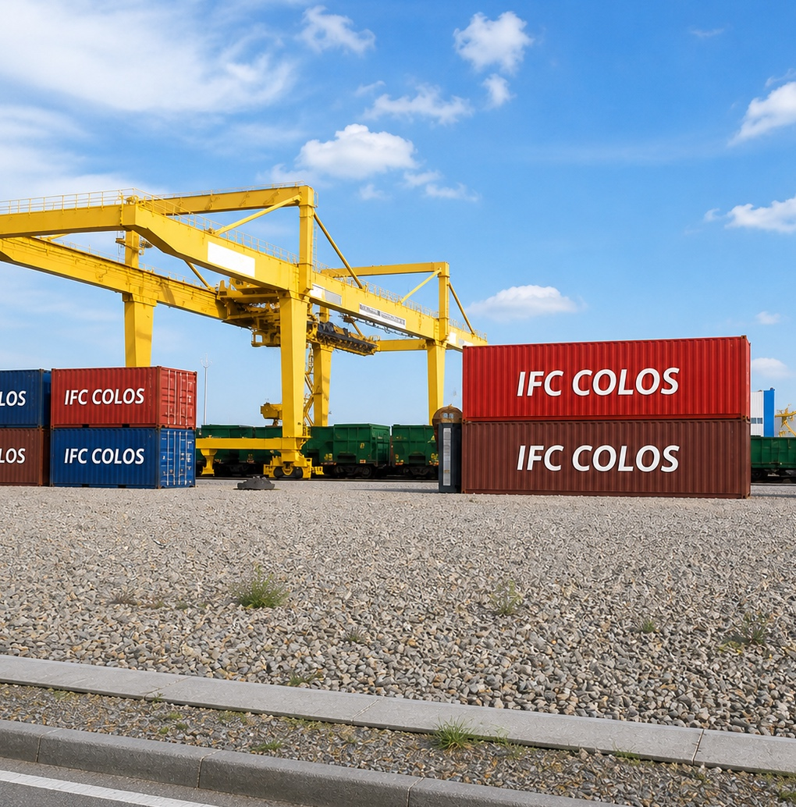
Special Economic Zone Khorgos - Eastern Gate
We are participants in the Khorgos SEZ, the largest industrial and logistics hub on the border of Kazakhstan and China at the heart of the New Silk Road.
BENEFITS FOR OUR CLIENTS:
Proximity to major transport hubs (motorways and railways).
Optimization of logistics routes and reduced delivery times.
Expeditious processing and storage of cargo at IFC Colos's own terminal.
Less-than-truckload (LTL) shipments and e-commerce solutions.
Reduction of cargo delivery time from China to Europe to 12-15 days from 40-45 days compared to sea shipping.
Access to the Eurasian market of 5.5 billion people.
16

Slide 17



Discover new horizons of possibilities with us!
IFC COLOS LLP
Head office: Republic of Kazakhstan, 050057, Almaty, Abay Avenue 76
+7 (727) 319 10 17, +7 (727) 319 10 18
+7 (701) 331-18-18 (24/7 Call Center)
info@colos.kz, hotmail@colos.kz
https://www.instagram.com/colos.kz/
https://www.facebook.com/www.colos.kz/
https://colos.kz/

